Slide 1
Rules of Engagement
CSCE 623
Dr. Brett Borghetti

Slide 2
What makes this ML course different from others?
Flipped format:
Read & watch videos outside of class
Work on activities & discussion in class
Instructor is your coach
Peers provide feedback (in class)
Major independent research project
Written Document and Presentation (video)
Part of your thesis/dissertation complete!

Slide 3
Course communication overview
MS Teams should be your prime method of communication
In-Person meetings in the classroom
If needed:
Online meetings w/audio and screen share
Urgent/private ways to contact instructor
Stay flexible – we may add/change/delete as the course evolves in this environment

Slide 4
Course Meeting schedule?
27 Mar – 3 Jun (+ finals week)
Class meetings (B646/R220) 0800-0950
Section 1: Mon/Wed
Section 2: Tues/Thurs
Class will start NLT 0800
Be signed into AU Teams & canvas since there will be online content there
We will take attendance at the start of each class

Slide 5
Course Meeting Format
Meetings will include lecture and learning activities; interaction and discussion encouraged!
If we are in online meeting mode
Use ‘raise hand’ in MS teams if you have a question
Audio required, but stay muted unless you need to talk/respond
Turn on Video when you are speaking unless there are bandwidth issues (you don’t need to have your camera on when you are not speaking)
Tip: Use headphones/earbuds (or headset) for your local audio output (reduces feedback)

Slide 6
How do I contact the instructor?
Dr. Brett Borghetti
Contact via M365 Teams (unless prohibited)
Alternate contact via email*
Send to AFIT and AU emails
*Until transition to .mil email…
prepend email subject lines with “[CSCE623]”
Phone/SMS Text only for emergency communication
Borghetti emergency only contact info: Personal Cell: 937-654-9946 (identify yourself & CSCE 623 in first text msg)

Slide 7
What if I have an issue?
Procedures issue (e.g. “Quiz 2 says its locked”)
Describe issue via teams message to the instructor with as much detail and maybe a screen capture since instructor may need to fix something in Canvas
Grading/Duty Availability issue (e.g. “My spouse got COVID and I have to take care of the kids” or “I’m concerned about my grade because …”):
Teams message (unless prohibited – then use email)

Slide 8
What if I have a content question?
C3B4ME: Check 3 sources* to see if you can find the answer
Figuring out what to search for or how to ask the question is halfway to solving it
Only after exhausting other sources in step 1, ask instructor via email
*Sources: Internet, textbook, Teams student discussion

Slide 9




Do we need a textbook?
Required Textbooks for the course:
Introduction to Statistical Learning (2nd ed), by James, Witten, Hastie, and Tibshirani (downloadable book + content: http://www-bcf.usc.edu/~gareth/ISL/ ) ←FREE PDF ISBN-13: ISBN-13: 978-071614174
Hands-On Machine Learning with Scikit-Learn & Tensorflow, by Aurelien Geron, Published by O’Reilly (3rd ed) Publisher: O'Reilly Media, Inc., Release Date: 2022 ISBN-13: 978-1-098-12597-4

Slide 10



Other helpful books You may find the following optional books helpful
The Elements of Statistical Learning, by Trevor Hastie, Robert Tibshirani, and Jerome Friedman (downloadable book + content: https://web.stanford.edu/~hastie/ElemStatLearn/ ) ←FREE PDF
Pattern Recognition and Machine Learning, by Christopher M. Bishop (some content available: http://research.microsoft.com/en-us/um/people/cmbishop/PRML/ )
The Hundred-Page Machine Learning Book, by Andriy Burkov
(Not to scale)

Slide 11
One required textbook uses R. What language are we using and why?
Answer: Python Local install: v 3.7 environment or later using Anaconda installer Cloud versions available (e.g. Google Colab)
Rationale:
Even though the book gives examples in R, the textbook continues to be very highly rated by AFIT students (and non-AFIT customers)
Python is easier to learn than R (for Computer Scientists)
Python is more powerful than R
Python is more widely used for serious machine learning and deep learning
Python 3.7 is compatible with keras and tensorflow – the deep learning environment we will use in CSCE 823

Slide 12
But the Book/Labs are in R…
Several websites have ported much content to Python… for example:
https://github.com/emredjan/ISL-python
https://github.com/JWarmenhoven/ISLR-python
https://github.com/collinprather/ISLR-Python

Slide 13
Where’s the course content?
Canvas
Should be visible to you (let me know if not)
MS Teams
Used primarily for online discussions but may include visuals developed while in online meetings

Slide 14
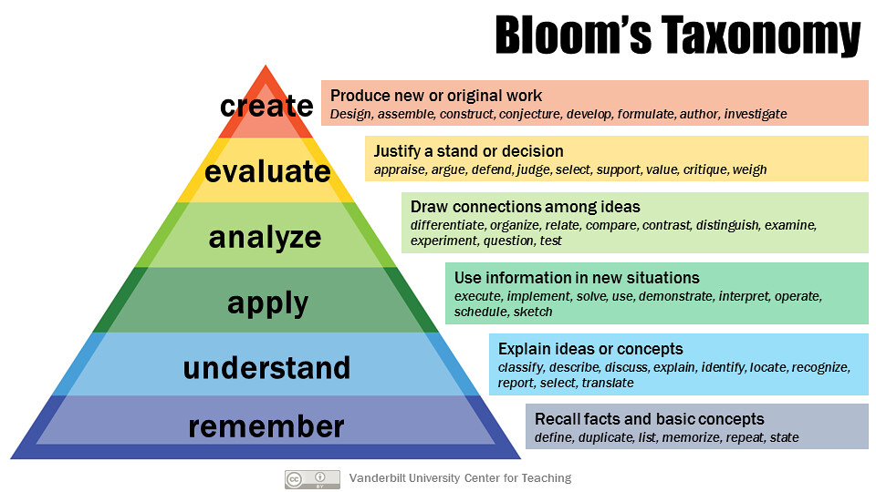
How are we learning? How are we being evaluated?
Modules 2-9
Research Project
Homework
Quizzes
In Class Activities
Reading, Videos Concept Checks
https://www.flickr.com/photos/vandycft/29428436431

Slide 15


Course Module Flow – Online
LEGEND
Module Overview
Learning Outcomes
Learning Assessment (Canvas)
Independent Activity
Parallel activities
Guided/Tutorial Activity
Solutions
Students complete pre-class prep
Students take concept check
Concept check submission unlocks additional content
learning activity
for some units
Homework Exercise
Graded Quiz
Homework: Grade plus feedback
Quiz may ask questions about HW and will be cumulative knowledge
Grade & Feedback
Pre-class activity:
Reading & Videos
Concept test (1 point)
Class on first day of week
Learning Activity:
(Online and/or In-Class)
Homework (5 points)
Class on second day of week
Submit HW
Quiz (5 points)
Instructor Review
Submit Quiz
Homework Solution
Homework Grading
Quiz Grading

Slide 16
How are we graded?
Points | Grade
≥ 94.0 | A
[90.0 94.0) | A-
[86.0 90,0) | B+
[83.0 86.0) | B
[80.0 83.0) | B-
[77.0 80.0) | C+
[73.0 77.0) | C
[70.0 73.0) | C-
[65.0 70.0) | D
<65.0 | F
Assessment | points
8x Concept Checks | 8
5x Homework | 25
5x Quizzes | 25
1x Project (4 deliverables) | 42
MAX POINTS = 100

Slide 17
What are “concept checks”?
Short questions which you will answer before attending the lecture (via Canvas)
Help keep you engaged with the material
Helps me know where you are struggling
Guide in-class discussions
1 point of Completion Credit per check: You will get full credit for completing the questions sincerely by the due date, but the questions are otherwise ungraded

Slide 18
What are HW assignments like?
HW Assignments (5 x 5pts each = 25 points)
Unguided Individual programming & written activity
Use the concepts from the unit to tackle a machine learning question
Work in Jupyter Notebook:
Code (w/comments) + Results + Explanatory text using Markdown
Submit Notebooks for graded credit
Example Solutions are unlocked as soon as you submit the homework; instructor feedback will be provided later

Slide 19
What are Quizzes like?
Quizzes(x5, 5pts each = 25 points)
Canvas Graded Quizzes will evaluate your understanding of all of the unit’s activities including the Homework
You may not yet have feedback on homework before the due date for the quiz – but you will have the solution
Quizzes will ask questions which may require knowledge of previous content from earlier modules

Slide 20
What is the final project like? (part 1 of 2)
A large-scale project designed to advance your* research using ML techniques
Research question involving data->answers
Get research started / evaluate high-risk ideas
Process / methodology / rigor are more important than findings
Great way to get publish an article written early in your degree program
Often becomes an important component in your thesis or dissertation
*If your research is doesn’t require ML, contact the instructor ASAP

Slide 21
What is the final project like? (part 2)
Deliverables
Proposal (7 pts): Initial explanation of idea, literature, and techniques you plan to use
First draft report (10 pts)
Project Video (10 pts)
Final report (15 pts)

Slide 22
Academic Integrity on Assignments
Rule #1: Don’t turn in other people's work…
Discussing HW & project approaches with peers is encouraged, but your submission should reflect your independent work
Don’t spoil a classmate’s opportunity to learn – each student should engage/struggle with the material before collaborating
Don’t look for specific solutions to assignment problems online or elsewhere - but looking up how to do something in python is OK.
If you are unsure about Academic Integrity, contact the instructor before doing something

Slide 23
Discussion & Collaboration
MS teams is the recommended location for discussing course content
Try to post content-related questions and content in an existing thread (reply) or make a new thread (new conversation) if your topic doesn’t have a thread
Students may answer each others' questions*
Be respectful of others when commenting or providing feedback
*discussing graded quizzes or the exam is prohibited unless explicitly authorized by the instructor

Slide 24
Academic Integrity on Quizzes
Don’t Discuss quiz solutions or approaches with anyone other than the instructor before or after turning them in
not everyone may take the quiz at the same time
Don’t “Post” solutions or approaches through any means (paper or digital) in a way that could be seen by someone other than the instructor

Slide 25
Recording class meetings (for online meetings)
The live synchronous class meetings will be recorded and should be available to students enrolled in the class on AU M365
Do not post or re-broadcast any portion of our online meetings without prior approval of instructor
If you would prefer to ask a question in an unrecorded session, let the instructor know so arrangements can be made:
At the end of the recorded live class
A separate live meeting

Slide 26
Your Professionalism
Make it easy for your peers to focus during online class meetings:
Avoid becoming distracted or distracting others (this includes out-of-channel voice/email/text/IM…)
During online meetings:
Maintain audio/video etiquette online (mute)
If you do use video, be aware of your appearance and what is in the background

Slide 27
The Culture of Learning
You are encouraged to:
Use online discussion with peers on the course content, material in books, videos, websites, etc.
Challenge yourself to get out of your comfort zone and understand the material deeply

Slide 28
Questions?

